Slide 1
Quantitative Analysis

Slide 2
Qualitative vs
Quantitative
Qualitative: relating to, measuring, or measured by the quality of something rather than its quantity.
  Tastes Great? Less Filling?
  myCourses has a user friendly interface?
Quantitative: relating to, measuring, or measured by the quantity of something rather than its quality.
  Miller Lite beer is ___ on the International Bitterness Units scale.
  myCourses responds on average ___ milliseconds per user request.
strongly
agree
agree
neutral
disagree
strongly
disagree

Slide 3
Tactics and Quantitative Analysis
Selecting architectural patterns and tactics requires a lot of qualitative decision making. Qualitative is necessary, but insufficient!
Need to evaluate design decisions and cross QA tradeoffs
Qualitative analysis – checklists, thought experiments
  Informal discussion – requirements covered, what can go wrong?
Evaluation can benefit from quantitative analysis
A more rigorous reasoning framework
Data, data, data!!
Notes:
How could this apply to Project 2?

Slide 4
Quantitative Analysis Guidance
Need a measurable quantitative characterization of the quality attribute of concern
Derived from QA scenarios:
  Stimulus, environment, response, response measure
Data sources - observations, experiments, modeling, or back-of-the-envelope estimates
Examples:
Availability – compute steady state availability
Performance – throughput, latency, utilization
mean time to failure
α =
mean time to failure + mean time to repair
Notes:
Alpha

Slide 5
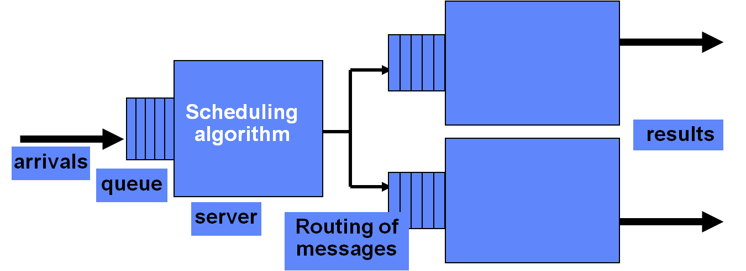
Queuing Network Analysis
Model the computer system as a network of queues associated with service centers
  Servers
  Networks
  Process components
Evaluate performance based on relatively simple equations derived from queuing theory

Slide 6
Queuing Network Analysis
. . .
Departing completed request
Arriving request
Queue
Service center i
Queue
Service center j
Estimate or measure the request arrival rate (λ) and the service rate (service time per request, μ)
Solving simple equations yields performance measures:
  Service center utilization (% busy)
  Residence time – average time spent at the service center (queuing + service); ~perceived response time
  Queue length
  Throughput – rate requests pass through the service center
Run “what if” experiments by varying λ and μ
Tool: http://jmt.sourceforge.net/
Quantitative System Performance, Lazowska, et al
Notes:
Lambda
Mu

Slide 7
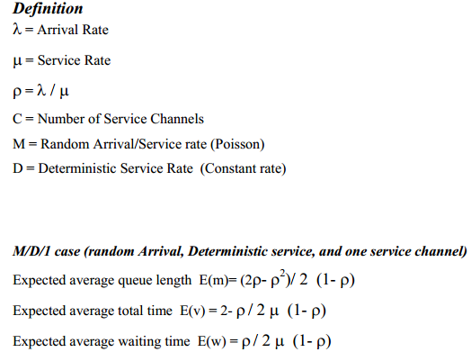

Queuing Network Analysis
Sample Equations
$(2−\text{ρ}\text{)/(2}μ(1−\text{ρ}\text{))}$
Notes:
Lambda
Mu
Rho

Slide 8
Simple Example
Completed Request
Request
Starbucks customers arrive at a rate of 20 per hour and take 2 minutes to serve.
μ = Service Rate = 60/2 = 30 customers per hour
What happens if the number of customers exceeds the service rate?
λ = Average Arrival Rate – either measured or estimated
When modeling queues, measurements are gathered and used to find a distribution that models the arrival rate.
Notes:
Mu
lambda

Slide 9
Simple Example
Completed Request
Request
Starbucks customers arrive at a rate of 20 per hour and take 2 minutes to serve.
μ = Service Rate = 30 customers per hour
λ = Average Arrival Rate = 20 customers per hour
ρ = Utilization Rate = λ/ μ = 20/30 = 2/3 = 66%
Notes:
Mu
Lambda
Rho

Slide 10
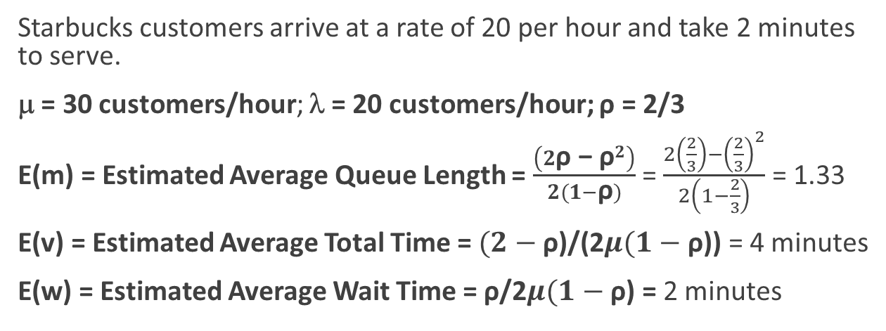
M/D/1 Example
Completed Request
Request
Starbucks customers arrive at a rate of 20 per hour and take 2 minutes to serve.
μ = 30 customers/hour; λ = 20 customers/hour; ρ = 2/3
E(m) = Estimated Average Queue Length = $\frac{\left(2\text{ρ}\text{ − }{\text{ρ}}^{2}\right)}{2(1−\text{ρ})}$ = $\frac{2\left(\frac{2}{3}\right)−{\left(\frac{2}{3}\right)}^{2}}{2\left(1−\frac{2}{3}\right)}$ = 1.33
E(v) = Estimated Average Total Time = $(2−\text{ρ}\text{)/(2}μ(1−\text{ρ}\text{))}$ = 4 minutes
E(w) = Estimated Average Wait Time =$\text{ρ}\text{/2}μ(1−\text{ρ}$) = 2 minutes
Notes:
M / D / 1 – Poisson / Deterministic / 1 Server
Mu
Lambda
Rho

Slide 11
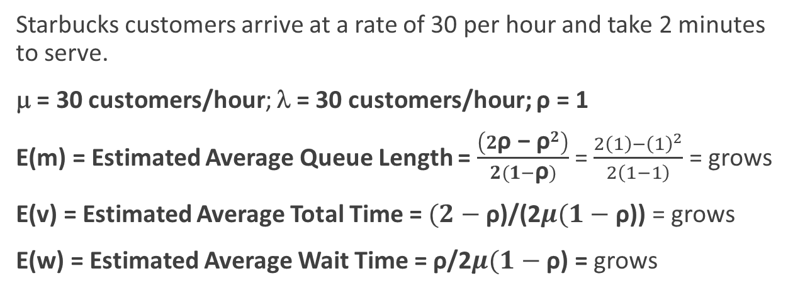
M/D/1 Example
Completed Request
Request
Starbucks customers arrive at a rate of 30 per hour and take 2 minutes to serve.
μ = 30 customers/hour; λ = 30 customers/hour; ρ = 1
E(m) = Estimated Average Queue Length = $\frac{\left(2\text{ρ}\text{ − }{\text{ρ}}^{2}\right)}{2(1−\text{ρ})}$ = $\frac{2\left(1\right)−{\left(1\right)}^{2}}{2\left(1−1\right)}$ = grows
E(v) = Estimated Average Total Time = $(2−\text{ρ}\text{)/(2}μ(1−\text{ρ}\text{))}$ = grows
E(w) = Estimated Average Wait Time =$\text{ρ}\text{/2}μ(1−\text{ρ}$) = grows
Notes:
M / D / 1 – Poisson / Deterministic / 1 Server
Mu
Lambda
Rho

Slide 12
Another Analysis Example:
Concurrent Pipelines
Problem - real-time latency requirements for generated outputs
The selected pattern - multiple processes arranged as concurrent pipelines
  Pipe and filter: a sequence of processes produces a final output by transforming a data stream
  Concurrent pipelines: multiple streams co-located on a single processor
    Real-time requirements on production of final outputs
  Stimulus - periodic or sporadic arrival of messages
  Response - worst-case latency associated with processing a message

Slide 13
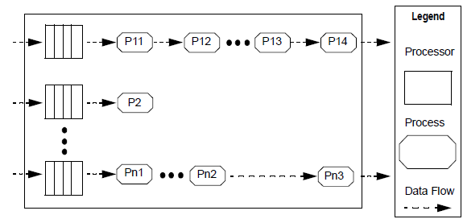
Architectural Pattern
Example Topology
FIFO

Slide 14
Performance Architectural Parameters
Topology: pipelines [a sequence of processes to be executed]
Preemption policy: priority-based preemption
Execution time for each process associated with processing each input: C_{i}
Prioritization strategy: sequence of priorities in the pipeline
Process scheduling discipline: fixed priority

Slide 15
Analysis
Relate architecture pattern and tactic decisions to stimulus/response behavior
Analysis focus – effects of process prioritization strategy on end-to-end latency?
Concurrent pipeline formal analysis:
  Computationally predict the end-to-end worst-case latency
Informal qualitative analysis heuristics
  Identify possible concurrent pipeline design issues based on experience

Slide 16
Formal Analysis Summary
Compute the worst-case latency for an input message using the i-th pipeline
Analysis:
  Incremental processing of inputs
  Each process step has a fixed computational time
  Each process step executed by a different process with its own fixed priority
  Latency of a message traversing i-th pipeline depends on preemptive effect of the other pipelines
  Effective priority of a pipeline is strongly related to the lowest priority of all processes in the pipeline

Slide 17
Latency Analysis
Worst-case latency for an input message using the i-th pipeline consisting of processes P_{i1}, P_{i2}, …, P_{im}
  Incremental processing of inputs
  Each increment can be made by a different process, each executing at its own fixed priority
  Latency of a message traversing i-th pipeline depends on preemptive effect of the other pipelines
    Determine lowest priority process in the i-th pipeline, LowP_{i}
    H = {pipelines that have all of their processes with priority greater than LowP_{i} }
    HL = { pipelines that start with processes of priority greater than LowP_{i} but eventually drop below LowP_{i} }
    LH = { pipelines that start with processes of priority lower than LowP_{i} but eventually rise above LowP_{i} }
“Fixed Priority Scheduling of Periodic Tasks with Varying Execution Priority” , Klein, et al, IEEE Real Time Systems Symposium, 1991

Slide 18

Latency Analysis (continued)
Calculate worst-case latency for the i-th pipeline by iteratively applying the following until it stabilizes
  Note sensitivity of pipeline’s latency to the priority of the lowest priority process in the pipeline under study (LowP_{i}), since it determines H, HL and LH
Effective priority of a pipeline is strongly related to the lowest priority of all processes in the pipeline
Notes:
l – latency
H = {pipelines that have all of their processes with priority greater than LowP_{i} }
HL = { pipelines that start with processes of priority greater than LowP_{i} but eventually drop below LowP_{i} }
LH = { pipelines that start with processes of priority lower than LowP_{i} but eventually rise above LowP_{i} }
C = Computational Requirement
T = Time Period

Slide 19
Qualitative Analysis and Design Heuristics
Given awareness of latency performance sensitivity to prioritization strategy, ask
  How does choice of priority assignment impact latency?
  Is there another prioritization strategy to reduce latency?
  Can the architecture design accommodate reprioritization?
  Is the effect of reallocating functionality to process easily understood?
  Assign higher priorities for shorter deadlines?
  Focus on job with longest completion time, not just first job?

Slide 20
Simplifying it …
Your measurements must be:
- Important to the product
- Measurable
- Repeatable
- Collectible
In other words, don’t get so fancy that you can’t get reliable data
Keep your math SIMPLE, so your calculations can be reliably made as well!
e.g. For performance: Keep a consistent input stream, run multiple times, take an average

Slide 21
Simpler equations
Average time to process
Min/ Max time
Processing time per TYPE of activity (maybe there is a pattern to the type of processing work; esp. in document processing, database queries, image processing
- Document Processing: Time per document type
- DB: Time per query type, or per table
- Image Processing: Time per file format; time per image time (faces, scenery, …)

